Slide 1
Time Series Analysis of Gold Prices
D-15
Malapati Kalyan Rohit – CB.SC.U4AIE23318
Renny Harlin D – CB.SC.U4AIE23334
Suganth K – CB.SC.U4AIE23340
Tharunkumar S – CB.SC.U4AIE23343

Slide 2
Dataset
Daily gold fixing price (10:30 am London time) in London Bullion Market in US dollars per Troy ounce from January 3, 1995, to November 10, 2016.
Objective
  Modelling the statistical behaviour and risk characteristics of gold over time

Slide 3
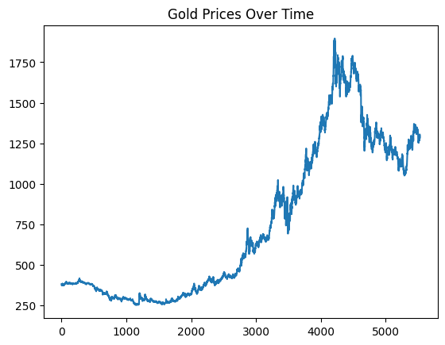
Data visualization

Slide 4
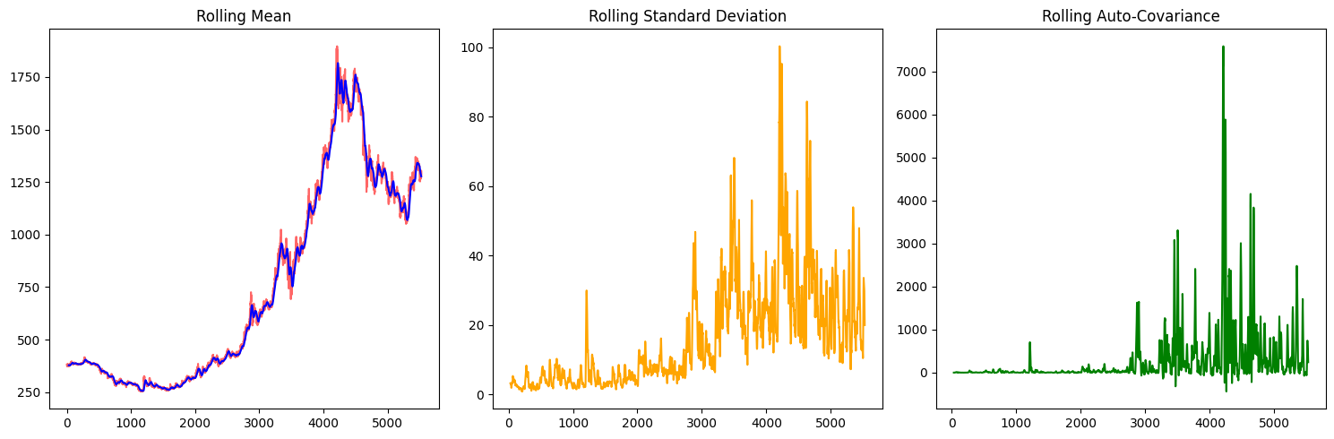
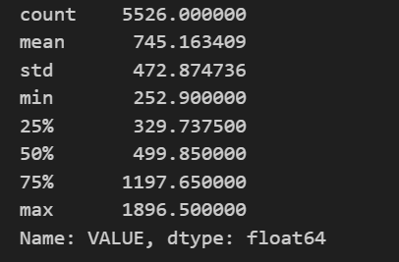
Statistical analysis

Slide 5
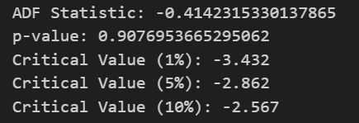
ADF-test on original series
(Augmented Dickey-Fuller Test)
Null Hypothesis: Not stationary
Alternate Hypothesis: Stationary
Since, p-value > 0.05 the series does not reject the null hypothesis, therefore it’s non-stationary

Slide 6
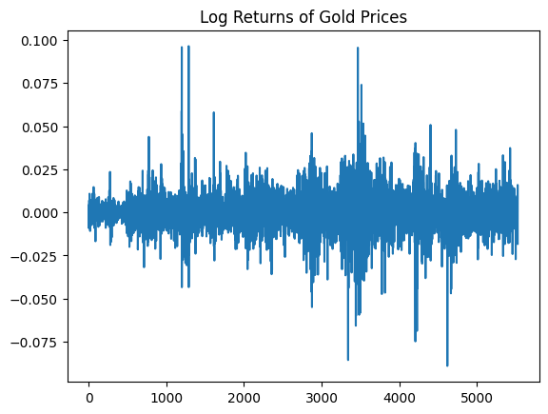
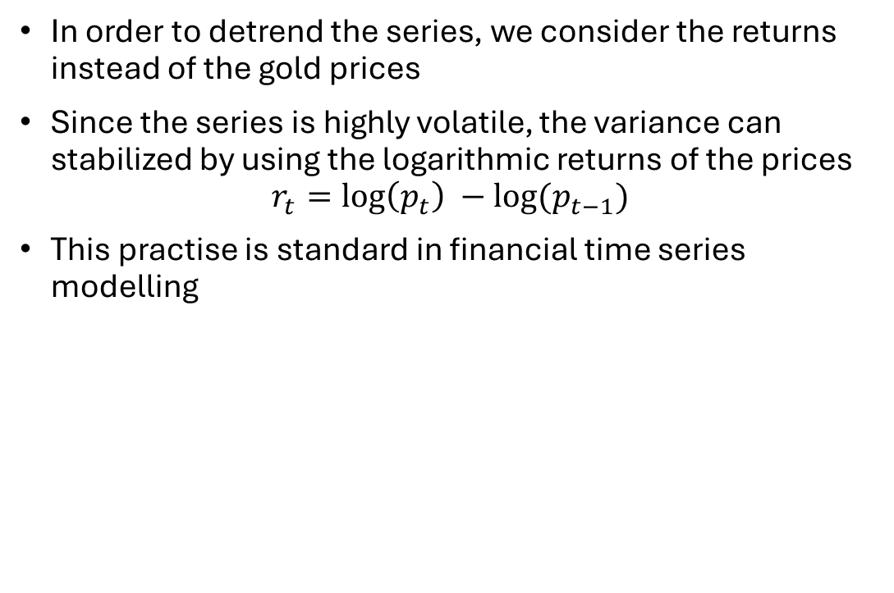
Detrend and stabilize variance
In order to detrend the series, we consider the returns instead of the gold prices
Since the series is highly volatile, the variance can stabilized by using the logarithmic returns of the prices
$$r_{t}=\log\left(p_{t}\right) −log⁡(p_{t−1})$$
This practise is standard in financial time series modelling

Slide 7
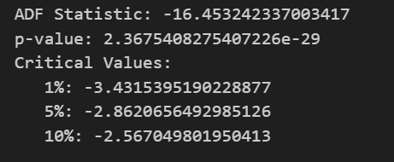
Retest for stationarity

Slide 8
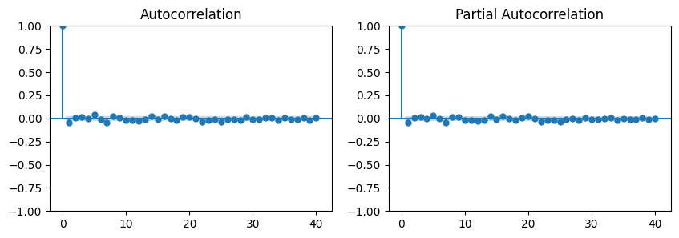
ACF and PACF plots
Both ACF and PACF plots cut off at 0 lag
This implies the series is white noise with mean 0 with no significant auto-correlation
ARIMA(0,0,0) can be used to model the mean

Slide 9

ARCH Test
(Autoregressive Conditional Heteroskedasticity)
The ARCH test checks whether a time-series has time varying variance
Null Hypothesis: No ARCH effects (constant variance)
Alternate Hypothesis: ARCH effects present (time-varying variance)
Reject Null Hypothesis => Use GARCH
p-value < 0.05 rejects the Null Hypothesis

Slide 10
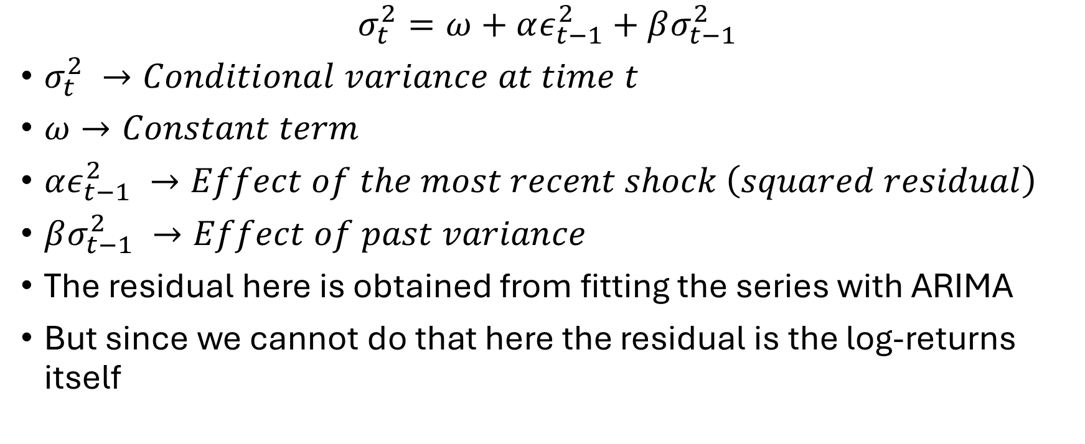
Modelling the variance using GARCH(1,1)
$$σ_{t}^{2}=ω+αε_{t−1}^{2}+βσ_{t−1}^{2}$$
$σ_{t}^{2} →Conditional variance at time t$
$ω→Constant term$
$αε_{t−1}^{2} →Effect of the most recent shock \left(squared residual\right)$
$βσ_{t−1}^{2} →Effect of past variance$
The residual here is obtained from fitting the series with ARIMA
But since we cannot do that here the residual is the log-returns itself

Slide 11
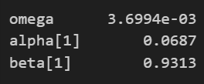
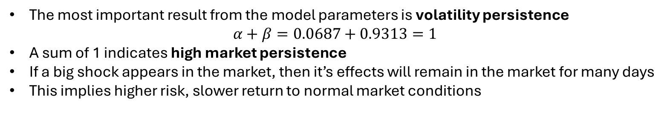
Inference from GARCH(1,1)
The most important result from the model parameters is volatility persistence
$$α+β=0.0687+0.9313=1$$
A sum of 1 indicates high market persistence
If a big shock appears in the market, then it’s effects will remain in the market for many days
This implies higher risk, slower return to normal market conditions

Slide 12
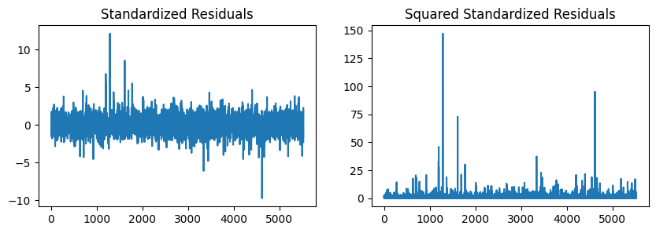
GARCH Residual Plots

Slide 13
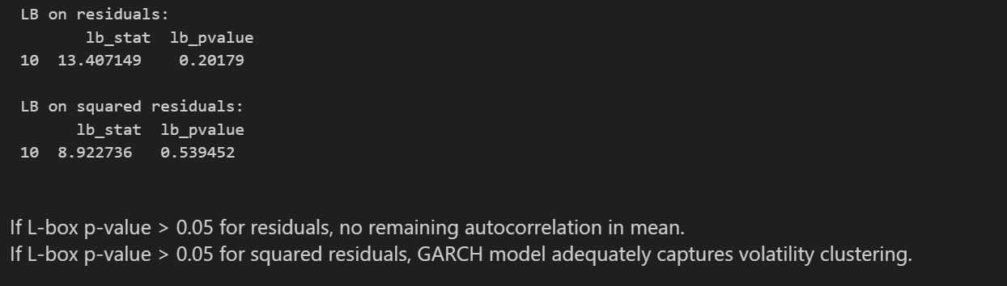
Ljung-Box test
After fitting time series models (ARIMA, GARCH)
  Residuals – no remaining dependence on mean
  Squared-residuals – no remaining dependence on variance

Slide 14
ARCH test on squared residuals
To verify that GARCH has captured all volatility clustering
p-value > 0.05 accepts Nulls Hypothesis that no ARCH effects are present (constant variance)

Slide 15
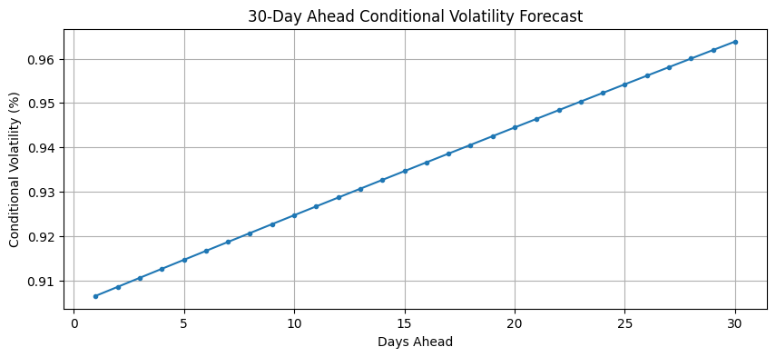
30-day volatility forecast
Volatility is expected to increase over the next month and then stabilize

